Slide 1
CIS 022 day 2
getting started with c++

Slide 2
Plan for today
Most of today's material will be review for people who've worked in C++ before
(and really, it will be largely review for people who've worked in Java or Python.)
There's going to be some stuff toward the end that might be entirely new to you, though.

Slide 3
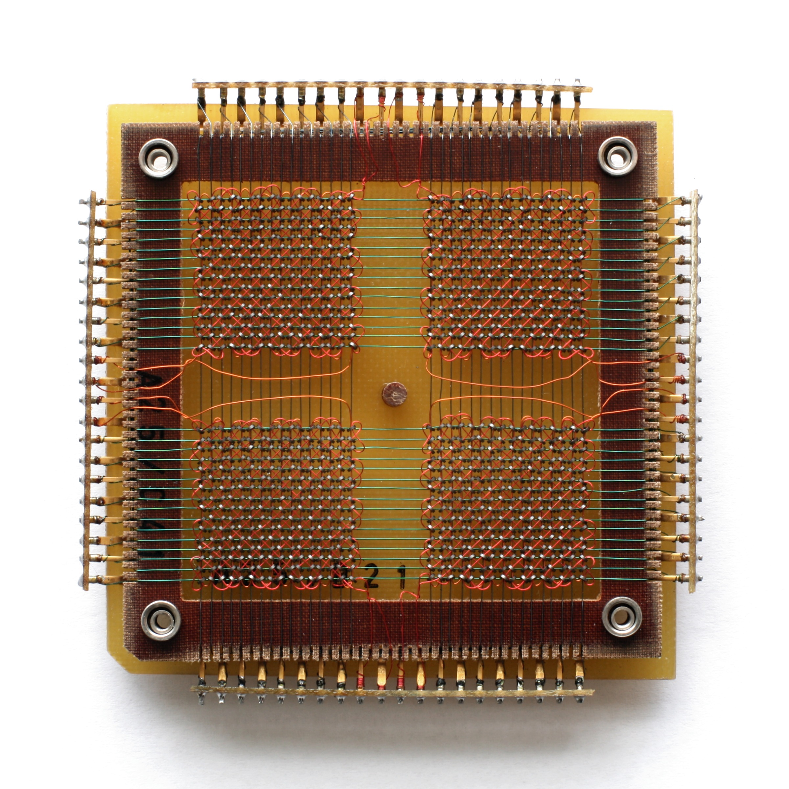
memory
this is what memory looked like in 1970s computers… the last time memory was big enough to see with the naked eye
The thing you will be doing most often when you write programs is writing to memory and reading from memory.
(if we were in an intro class we'd talk about how CPUs work right now. This is not an intro class, so we're just going to discuss memory.)
this board holds about 768 bits (I counted!)

Slide 4

memory
here's a zoomed-in picture of 1970s memory – each one of these metal disks is a bit. it's a 1 if it's magnetized and a 0 if it's not.
The thing you will be doing most often when you write programs is writing to memory and reading from memory.
(if we were in an intro class we'd talk about how CPUs work right now. This is not an intro class, so we're just going to discuss memory.)
(this is about 72 bits)

Slide 5
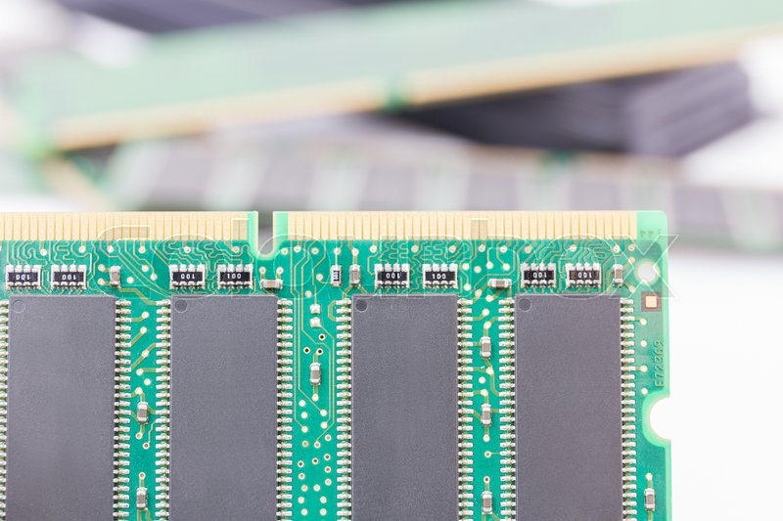
memory
here's a modern memory chip – this board contains billions of bits, all of which are far too small to see
The thing you will be doing most often when you write programs is writing to memory and reading from memory.
(if we were in an intro class we'd talk about how CPUs work right now. This is not an intro class, so we're just going to discuss memory.)
this board holds about 128,000,000,000 bits.

Slide 6
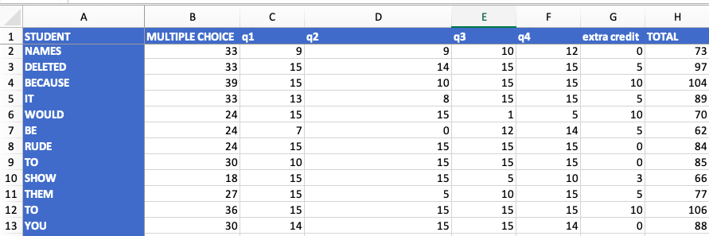
memory – an analogy
You can think of your computer's memory as something like a gigantic spreadsheet.
Each cell on the spreadsheet (or each address in memory) can hold a piece of data – a number, a string of letters, a true-or-false value, etc.
true-or-false values are called booleans

Slide 7
memory – an analogy
we can think of this as the
string "extra credit" stored at
address G1 on the spreadsheet
You can think of your computer's memory as something like a gigantic spreadsheet.
Each cell on the spreadsheet (or each address in memory) can hold a piece of data – a number, a string of letters, a true-or-false value, etc.
We can think of this as the integer 30 stored at the address B13 on the spreadsheet

Slide 8
memory – another analogy
Addresses on a spreadsheet is two dimensional… but on your computer, memory addresses are sequential, in a line
You can think of your computer's memory as an extremely long strip of paper, divided up into little boxes. Each box can hold one piece of data (a number, a string, a boolean value, etc.)
The first box is at address 0, the second is at address 1, the third box is at address 2, and so forth… all the way to address 128,000,000,000 (or whatever, depending on how much memory your computer has.)
137
23.5
「今日は」
"hello"
"world"
true
'c'
23
address:
0
1
2
3
4
5
6
7
…
* this is a simplification for the purpose of this class. if you want to know the details, take systems programming

Slide 9
FROM BITS TO BOXES
Now you may be thinking:
Bits are 0s and 1s
Boxes are numbers, letters, strings of letters… how do you turn 0s and 1s into numbers and words?
137
42
「今日は」
23
"hello"
"world"
true
false
0
1
2
3
4
5
6
7
…

Slide 10
HOW BINARY WORKS
The trick is binary notation -- counting in base two
BASE TWO | BASE TEN
0 | 0
1 | 1
10 | 2
11 | 3
100 | 4
101 | 5
110 | 6
111 | 7
1000 | 8
1001 | 9
1010 | 10
you can represent
the number ten
with 4 bits
「你好」
137
42
"hello"
"world"
true
false
23
0
1
2
3
4
5
6
7
…

Slide 11
HOW BINARY WORKS
The trick is binary notation -- counting in base two
BASE TWO | BASE TEN
0 | 0
1 | 1
10 | 2
11 | 3
100 | 4
101 | 5
110 | 6
111 | 7
1000 | 8
1001 | 9
1010 | 10
that's how you can represent numbers like 137 or 42 in a computer – by using bits to write down the base two version.
「你好」
137
42
"hello"
"world"
true
false
23
0
1
2
3
4
5
6
7
…

Slide 12
HOW BINARY WORKS
QUICK QUIZ:
you can represent 8 different numbers with 3 bits (every number from 0 to 7)
how many different numbers can you represent with four bits?
what about five bits?
(spend a minute or so working it out on paper if you need to)
BASE TWO | BASE TEN
0 | 0
1 | 1
10 | 2
11 | 3
100 | 4
101 | 5
110 | 6
111 | 7
1000 | 8
1001 | 9
1010 | 10
you can represent
the number ten
with 4 bits

Slide 13
FROM NUMBERS TO LETTERS
Okay, that's how we represent numbers. But how do we represent letters and words?
Note: obviously these boxes aren’t all the same size – different types of variables take different amounts of space.
An integer generally takes 4 bytes of space (32 bits). A single character takes 1 byte. A string takes up (at least) the number of bytes required to store the number of characters in the string.
「你好」
137
42
"hello"
"world"
true
false
23
0
1
2
3
4
5
6
7
…

Slide 14
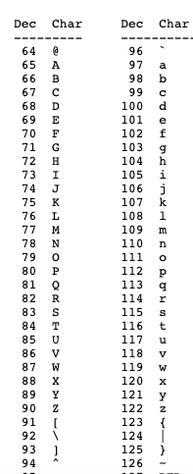
FROM NUMBERS TO LETTERS
Here's the trick: there's an arbitrary standard called ASCII (short for "American Standard Code for Information Interchange" that tells how to translate from letters to numbers.
ASCII uses 7 bits to store each letter, plus another bit for error detection (we'll talk about this later on when we talk about networking). How many different characters can you represent in 7 bits?
8 bits is called a byte. A single character is 1 byte. A word (or a sentence, or a paragraph, or a novel…) is a bunch of single characters put together in a string.
See www.asciitable.com
the number 65 means capital A.
the number 113
means lowercase q

Slide 15

WHAT ABOUT你好 and مرحبا andこんにちは?
ASCII (8 bits) can only represent characters in the Latin character set
What about all the other character sets in the world?
Unicode is a character encoding that uses up to 32 bits (4 bytes) to represent each character.
Because it's 4 bytes wide, Unicode can represent 4,294,967,296 different characters – 2³².
(Nearly) every language in the world can be represented in Unicode
We'll be (mostly) just using ASCII characters in this class, because our programming tools make it easier to work in ASCII than in Unicode ☹
it's actually a little less than this – to find out why, take systems programming

Slide 16
hello world in C++
because some folks learned to code in Python and Java

Slide 17
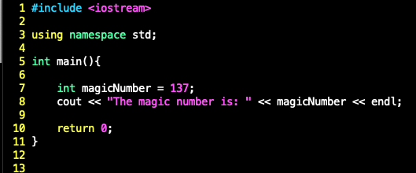
SAMPLE PROGRAM
Here's a sample program:
you'll put this at the
top of nearly every
program in this class. it imports the code that lets you use input and output streams

Slide 18
SAMPLE PROGRAM
Here's a sample program:
you'll put this at the
top of nearly every
program in this class
(in later C++ courses, and in industry, doing things this way is often considered bad practice. It simplifies the syntax enough that it's worth doing in this course, though.

Slide 19
SAMPLE PROGRAM
Here's a sample program:
int main()
is the function where program execution starts.
For python programmers: the code in int main() is equivalent to the code you call from
if __name__ == "__main__":

Slide 20
SAMPLE PROGRAM
Here's a sample program:
int main()
is the function where program execution starts.
For Java programmers: this is equivalent to
public static void main(String[] args)

Slide 21
SAMPLE PROGRAM
Here's a sample program:
int, here, is the return type of the function. When this function ends, it passes back an int: an integer value

Slide 22
SAMPLE PROGRAM
Here's a sample program:
int, here, is the return type of the function. When this function ends, it passes back an int: an integer value.
By convention, main() always returns 0.
Why? When the program ends, the operating system can do different things based on what value your program returns. If your program runs successfully and gets to the end of main(), it will return 0 – which (again by convention) indicates that your program has run successfully. If something causes your program not to run successfully – say that it crashes – it will return some value other than 0.

Slide 23
SAMPLE PROGRAM
Here's a sample program:
Here I'm declaring a variable. In C++, unlike in Python, you must declare a variable before you use it.

Slide 24
SAMPLE PROGRAM
Here's a sample program:
This is the type of the variable – an int, same as main()'s return type

Slide 25
SAMPLE PROGRAM
Here's a sample program:
And here I'm initializing the variable – setting it equal to 137

Slide 26
SAMPLE PROGRAM
Here's a sample program:
As in most languages, you assign a value to a variable by using a single = sign. If you want to test whether two variables are equal, use == instead.

Slide 27
SAMPLE PROGRAM
Here's a sample program:
Here's how you do output in C++
cout is short for console out. It means "print to the screen." cout is a "stream" – for now, just think of a stream as something you can write to or read from. << is the stream insertion operator. It means "put everything on the right hand side of << into the stream on the left hand side of <<

Slide 28
SAMPLE PROGRAM
Here's a sample program:
Here's how you do output in C++
endl means "end line" – this inserts a newline character into the stream

Slide 29
SAMPLE PROGRAM
Here's a sample program:
If we didn't include using namespace std at the top of this file, we'd have to use somewhat more complicated syntax here:

Slide 30
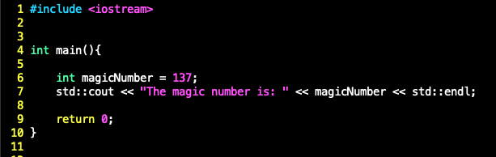
SAMPLE PROGRAM
Here's a sample program:
If we didn't include using namespace std at the top of this file, we'd have to use somewhat more complicated syntax here:

Slide 31
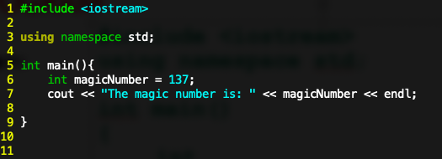
SAMPLE PROGRAM
Karel (deliberately) doesn't include variables.
(that's what makes the puzzles interesting)
What does it mean to "declare a variable" in C++?
It means to set aside space in memory for that type of variable.
So this command means set aside space in memory for an int (a whole number; something without a decimal point) and then stores the number 137 there.

Slide 32
sample PROGRAM
When the compiler sees this command, it grabs a box that isn't storing anything yet (one that's the appropriate size for an int) and then stores the number 137 there.
「你好」
23
42
137
true
false
23
0
1
2
3
4
5
6
7
…
done!

Slide 33
sample PROGRAM
When the compiler sees this command, it grabs a box that isn't storing anything yet (one that's the appropriate size for an int) and then stores the number 137 there.
It would be pretty inconvenient to have to refer to this variable by its address, so we give it a name: magicNumber.
Now whenever we want to refer to the variable at address 2 (or whatever address the compiler assigns), we can use its name: magicNumber
「你好」
23
42
137
true
false
23
0
1
2
3
4
5
6
7
…

Slide 34
sample PROGRAM (syntax note)
Syntax note: remember how in Karel when we defined a function we used the function keyword, followed by the function's name: function safeMove() { if(frontIsClear()){ move(); } }
But when we used the function we just used its name: function main(){ safeMove(); }
「你好」
23
42
137
true
false
23
0
1
2
3
4
5
6
7
…

Slide 35
sample PROGRAM (syntax note)
Syntax note:
C++ works the same: When you define a variable, you use the type of the variable, followed by the variable's name
(this tells the compiler how much space in memory it needs to set aside for the variable)
In this case, the type is int
「你好」
23
42
137
true
false
23
0
1
2
3
4
5
6
7
…

Slide 36
sample PROGRAM (syntax note)
Syntax note:
But when you use the variable, you just give its name.
Using a variable means "go fetch the thing that's in the box you've set aside for this name."
「你好」
23
42
137
true
false
23
0
1
2
3
4
5
6
7
…

Slide 37
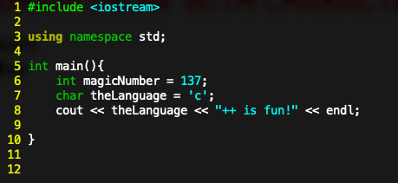
sample PROGRAM (now with characters)
Okay, but what if we want to store something other than numbers?
If we want to store a single character, we use the char type
This command means "set aside space in memory for the character 'c'
You might remember that characters are just numbers
So when you use the char type, it also means "when you use this type later on, look up its value in the ASCII table and use the letter associated with that number
「你好」
23
42
137
'c'
23
0
1
2
3
4
5
6
7
…
this looks like a good space!

Slide 38
sample PROGRAM (now with characters)
so the value stored at address 4 is really 99… but whenever you print it out it's automatically converted to the letter c
「你好」
23
42
137
"world"
'c'
23
0
1
2
3
4
5
6
7
…
this looks like a good space!

Slide 39
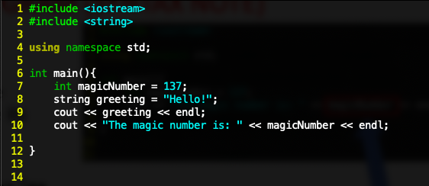
sample PROGRAM (now with strings)
Okay, but what if we want to store whole words?
we have to include the string library, like so:
a
「你好」
23
42
137
"world"
23
0
1
2
3
4
5
6
7
…

Slide 40
sample PROGRAM (now with strings)
Okay, but what if we want to store whole words?
We have to include the string library, like so:
Then we declare a variable of type "string." This sets aside space in memory for a whole bunch of characters. We name this string greeting, and store the value "Hello!" there.
「你好」
23
42
137
"world"
23
0
1
2
3
4
5
6
7
…

Slide 41
sample PROGRAM (now with strings)
There is another, older way to store strings in c++. These are called c-strings, and we'll talk about them when we have to.
(long story short: c-strings are just arrays of characters. They're slightly more efficient than c++ style strings, but much more annoying to work with)
(we'll talk about arrays in a few slides)
「你好」
23
42
137
"world"
23
0
1
2
3
4
5
6
7
…

Slide 42
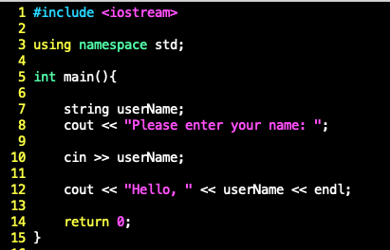

sample PROGRAM (now with input)
Okay, you know how to write data to the console. How do you read data from the keyboard?
You do this using cin (short for console in) and >> (the stream extraction operator)

Slide 43
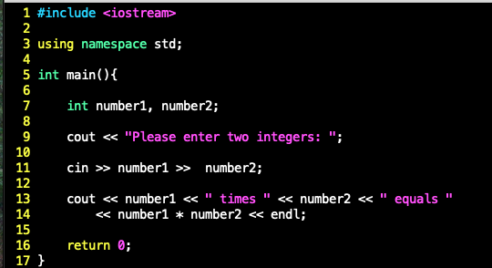

sample PROGRAM (now with input)
You can read multiple values at once by stringing together multiple copies of the stream extraction operator

Slide 44
Floating-Point Data Types (1 of 3)
C++ uses scientific notation to represent real numbers (floating-point notation)
Decimal Number | Scientific Notation | C++ Floating-Point Notation
75.924 | 7.5924 * 10¹ | 7.592400E1
0.18 | 1.8 * 10⁻¹ | 1.800000E-1
0.0000453 | 4.53 * 10⁻⁵ | 4.530000E-5
–1.482 | -1.482 * 10⁰ | -1.482000E0
7800.0 | 7.8 * 10³ | 7.800000E3
* this slide and the next few slides are stolen from a textbook apologies if they're boring and/or ugly

Slide 45
Floating-Point Data Types (2 of 3)
float: represents any real number
Range: -3.4 * 10³⁸ to 3.4 * 10³⁸ (four bytes)
double: represents any real number
Range: –1.7 * 10³⁰⁸ to 1.7 * 10³⁰⁸ (eight bytes)
Minimum and maximum values of data types are system dependent

Slide 46
Floating-Point Data Types (3 of 3)
Maximum number of significant digits (decimal places) for float values: 6 or 7
Maximum number of significant digits for double: 15
Precision: maximum number of significant digits
float values are called single precision
double values are called double precision

Slide 47
Data Types, Variables, and Assignment Statements
To declare a variable, must specify its data type
Syntax rule to declare a variable is:
dataType identifier;
Examples include:
int counter;
double interestRate;
char grade;
Assignment statement has the form:
variable = expression
Example: interestRate = 0.05;

Slide 48
Arithmetic Operators, Operator Precedence, and Expressions (1 of 2)
C++ arithmetic operators include:
+ addition
- subtraction (or negation)
* multiplication
/ division
% mod (modulus or remainder)
+, -, *, and / can be used with integral and floating-point data types
Modulus (%) can only be used with integral data types

Slide 49
Arithmetic Operators, Operator Precedence, and Expressions (2 of 2)
When you use / with integral data types, the integral result is truncated (no rounding)
Arithmetic expressions contain values and arithmetic operators
Operands are the numbers appearing in the expressions
Operators can be unary (one operand) or binary (two operands)

Slide 50
Order of Precedence
All operations inside () are evaluated first
*, /, and % are at the same level of precedence and are evaluated next
+ and - have the same level of precedence and are evaluated last
When operators are on the same level
Operations are performed from left to right (associativity)
3 * 7 - 6 + 2 * 5 / 4 + 6 means (((3 * 7) – 6) + ((2 * 5) / 4 )) + 6

Slide 51
Expressions
Integral expression: all operands are integers
Yields an integral result
Example: 2 + 3 * 5
Floating-point (decimal) expression: all operands are floating-point
Yields a floating-point result
Example: 12.8 * 17.5 - 34.50

Slide 52
Mixed Expressions (1 of 2)
Mixed expression
Has operands of different data types
Contains integers and floating-point
Examples of mixed expressions
2 + 3.5
6 / 4 + 3.9
5.4 * 2 – 13.6 + 18 / 2

Slide 53
Mixed Expressions (2 of 2)
Evaluation rules
If operator has same types of operands
The operator is evaluated according to the type of the operands
If operator has both types of operands
Integer is changed to floating-point
Operator is evaluated
Result is floating-point
Entire expression is evaluated according to precedence rules

Slide 54
Type Conversion (Casting) (1 of 2)
Implicit type coercion: when the value of one type is automatically changed to another type
Cast operator (also called type conversion or type casting): provides explicit type conversion
static_cast<dataTypeName>(expression)
Note: If, later in the class, you find yourself implementing systems where you have to use casting, this is generally a sign that your design is not great. Casting is somewhat dangerous – the type system is there to protect you from unpredictable and hard-to-diagnose errors produced by supplying the wrong type of data to functions, and by circumventing the type system through casting you’re opening yourself up to all of those errors.

Slide 55
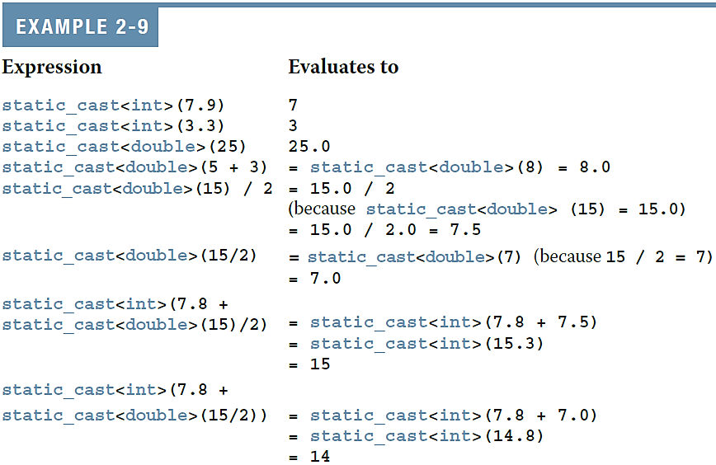
Type Conversion (Casting) (2 of 2)

Slide 56
PAUSING FOR A SECOND
There are aspects of the rest of this talk (and of this course as a whole) that are COMPLICATED
No, like seriously, it's complicated. Back in undergrad, it took me a little while to get some of this stuff. When I did, I felt a bit like I had just seen the matrix.
It is review for some of you. It is definitely not review for others.
I don't expect you to get all of this today. I'm introducing it now so that you'll have a better shot at getting it by the end of the semester.

Slide 57

WHAT TO DO WHEN YOU'RE AHEAD OF YOUR CLASSMATES
022 students
Say you're like "Karel was super easy and I get this C++ stuff completely"
Make sure your neighbors (and other classmates) get the material too! The best way to learn something better is to teach it to someone else
(as I learned when I started teaching)
☆ Help your comrades ☆
man, or woman, or non-binary/genderqueer person

Slide 58
WHAT TO DO WHEN YOU'RE BEHIND YOUR CLASSMATES
022 students
Say you're thinking "I don't understand Karel and C++ frightens me and I don't know what to do"
Ask your neighbors for help!
I'm about to make everyone promise to help their neighbors whenever they can.
☆ Get help from your comrades ☆
man, or woman, or non-binary/genderqueer person

Slide 59
rules for sharing
022 students
It is awesome to help your classmates with how to design their algorithms.
It is awesome to help your classmates with how C++ syntax works
It is not awesome to show them your code. You're not really helping if you just let people copy off of you.
man, or woman, or non-binary/genderqueer person
helping each other is dope

Slide 60
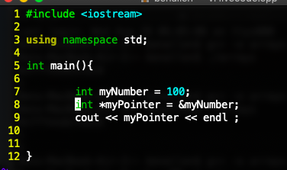

memory – an analogy
real addresses don't look quite like this, of course…
You can get the address of an object in memory by using the & operator:
11100010
10101010
11111111
01110011
00110011
00110011
11001100
00110011
address:
0
1
2
3
4
5
6
7
…
here's what I get when
I run this. this is what addresses typically look like… long hexadecimal numbers
a variable that stores an address is called a pointer. we'll talk about pointers in a second

Slide 61
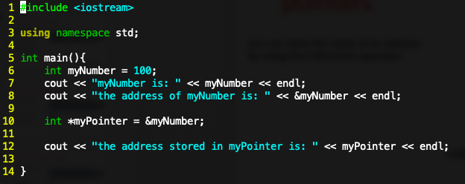

pointers
a pointer is a variable type that stores the address of another variable
you can store the value of an address by using the * indirection operator before the name of a pointer. once you have an address in the pointer, you can use the * operator again to get what's stored at the address. This is called "dereferencing the pointer"
real addresses don't look quite like this, of course…
11100010
10101010
11111111
01110011
00110011
00110011
11001100
00110011
address:
0
1
2
3
4
5
6
7
…
here's what I get when
I run this

Slide 62
pointers
real addresses don't look quite like this, of course…
a pointer is a variable type that stores the address of another variable
11100010
10101010
11111111
01110011
00110011
00110011
11001100
00110011
declare a pointer by using the name of the type, and then putting * before the name you assign to the pointer.
address:
0
1
2
3
4
5
6
7
…
here's what I get when
I run this

Slide 63
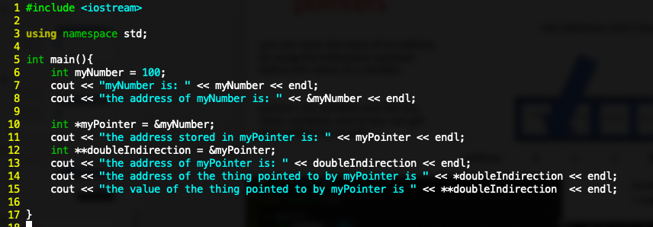
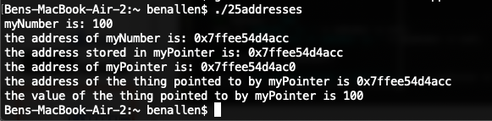
pointers
pointers are variables just like any other variables, and so you can get their addresses as well:
here's what I get when
I run this

Slide 64
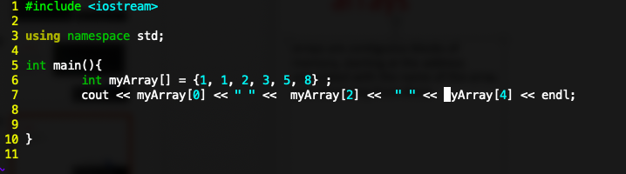

okay so what's an array
arrays are contiguous blocks of memory, starting at the address associated with the name of the array and advancing from there.
1
1
2
3
5
8
here's what I get when
I run this
myArray[0]
myArray[1]
myArray[2]
myArray[3]
myArray[4]
myArray[5]

Slide 65
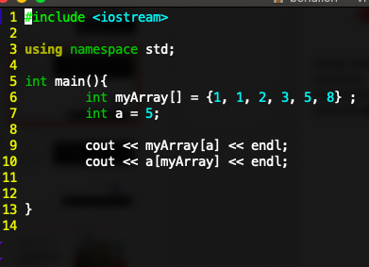

arrays
this is maybe
the weirdest
thing I'll show
you all semester. if you don't get
it, that's fine...
you will by
about seven
weeks from now
arrays are contiguous blocks of memory, starting at the address associated with the name of the array and advancing from there.
here's what I get when
I run this

Slide 66
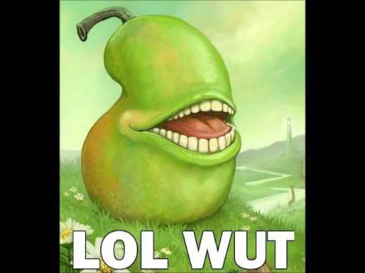
arrays
this is maybe
the weirdest
thing I'll show
you all semester. if you don't get
it, that's fine...
you will by
about seven
weeks from now
arrays are contiguous blocks of memory, starting at the address associated with the name of the array and advancing from there.
here's what I get when
I run this

Slide 67
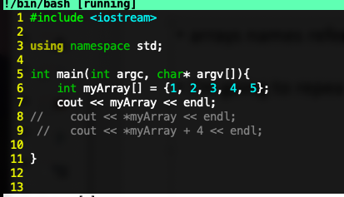

arrays under the hood
arrays names refer to addresses.
I'm going to repeat this again: array names refer to addresses.
when I run this:
it's an address!
I get this:

Slide 68
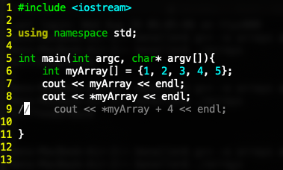

arrays under the hood
if you dereference an array using the * operator, you get the first value in the array
… cool, right?
when I run this:
I get this:
it's the value at myArray[0]

Slide 69
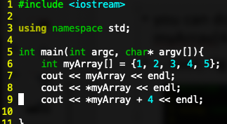

arrays under the hood
you can do math with addresses. *(myArray + 4) is the same value as myArray[4]
… weird, right?
when I run this:
I get this:
this is called pointer math.
you can do deep magic with it... but use it sparingly. I'm not showing it to you so that you can use it all the time. I'm showing it to you so that you know what arrays are under the hood
it's the value at myArray[4]

Slide 70
Putting it all together
Say you’ve got the following array:
int myArray[4] = {2, 3, 23, 137};
myArray[0] is the value of the first element of the array: 2
myArray by itself is the address of the first element of the array (some long hexadecimal number)
myArray + 1 is the address of the second element of the array
*(myArray + 1) is the value of the second element of the array: 3
*(1 + myArray) is also the value of the second element of the array, because addition is commutative
Therefore… and this is something you should literally never do…
1[myArray] is equivalent to myArray[1].
Most languages don’t let you do weird stuff like this. C++ is like “LOL, okay, you want to do that weird thing? Go ahead!” This is indicative of the design of C++. It can be incredibly powerful, because it lets you do weird, useful things… but it also can be incredibly frustrating, because it doesn’t stop you from accidentally doing weird, useless things.

Slide 71
expectations
You will not be expected to do fancy stuff with pointers and addresses (or really, to use pointers at all) until a few weeks into the class. don't freak out if you're confused right now.

